Slide 1
Memory Management

Slide 2
Background
Program must be brought into memory and placed in Q for processing/ exe/ run
Input queue – collection of processes on the disk that are waiting to be brought into memory to run the program
User programs go through several steps before being run

Slide 3
The Need for Memory Management
Memory is cheap today, and getting cheaper
But applications are demanding more and more memory, there is never enough!
Memory Management, involves swapping blocks of data from secondary storage.
Memory I/O is slow compared to a CPU
The OS must cleverly time the swapping to maximise the CPU’s efficiency
Notes:
Introduce by pointing out that in a uniprogramming system, main memory is divided into two parts:
one part for the operating system (resident monitor, kernel) and
one part for the program currently being executed.
In a multiprogramming system, the “user” part of memory must be further subdivided to accommodate multiple processes.
Emphasise that memory management is vital in a multiprogramming system. If only a few processes are in memory, then for much of the time all of the processes will be waiting
for I/O and the processor will be idle.
Thus memory needs to be allocated to ensure a reasonable supply of ready processes to consume available processor time.

Slide 4
Memory Management
Memory needs to be allocated to ensure a reasonable supply of ready processes to consume available processor time.
Notes:
https://www.youtube.com/watch?v=TAk822Wz4x4
https://www.youtube.com/watch?v=LLhgnIYpQaI

Slide 5
Binding of Instructions and Data to Memory
Address binding of instructions and data to memory addresses can happen at three different stages
Compile time: If memory location known as prior, absolute code can be generated.
Must recompile code if starting location changes
Load time: Must generate relocatable code if memory location is not known at compile time
Execution time: If the process can be moved during its execution from one memory segment to another. Need hardware support for address maps (e.g., base and limit registers).
Notes:
Binding is a term that refers to the semantics, or action, associated with a name, or symbol.

Slide 6
Logical vs. Physical Address Space
The concept of a logical address space that is bound to a separate physical address space is central to memory management
Logical address – generated by the CPU; also referred to as virtual address
Physical address – address seen by the memory unit
Logical (virtual) and physical addresses differ in execution-time.

Slide 7
Virtual and physical addresses
Program uses virtual addresses
Addresses local to the process
Hardware translates virtual address to physical address
Translation done by the MMU (Memory Management Unit)
Usually on the same chip as the CPU
Only physical addresses leave the CPU/MMU chip
CPU chip
CPU
MMU
Virtual addresses from CPU to MMU
Memory
Physical addresses on bus, in memory
Disk controller

Slide 8
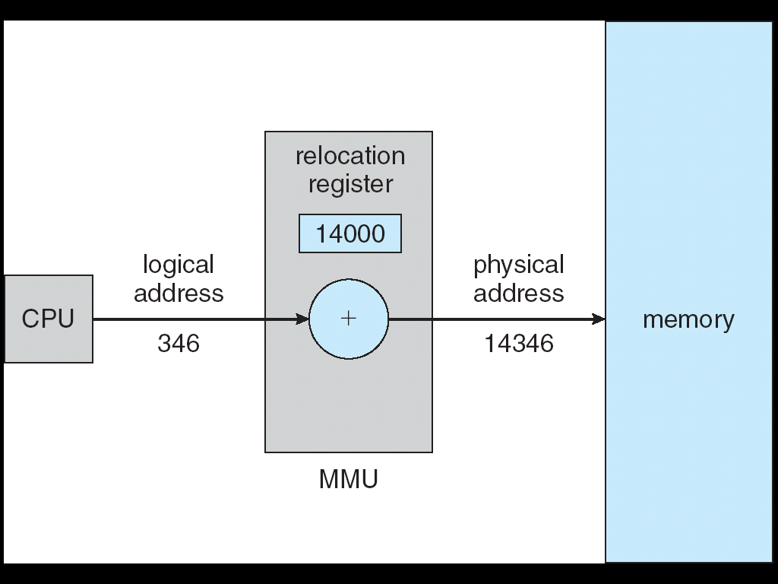
Dynamic relocation using a relocation register
Notes:
Say a application needs something computed by the CPU. That application says to the CPU, "I'm going to send you 500 pieces of data, so I need a space in the memory that is 500 pieces of data big." So the CPU takes a look at the memory. Initially there is room for 10,000 pieces of data, but because there are other processes already running the first 1 - 2,000 pieces are already taken up. The CPU says to himself from piece 2,000 to 2,500 is were all new data is going to go. The physical memory is the address from 2,000 to 2,500. Now the application doesn't realize that there are other processes that the CPU is taking care of. All it sees is the data 1- 500 pieces stored in the memory. This is logical memory. When the application wants to run a piece of data of the 1-500, its says to the CPU run the piece 130. In reality 130 is not even a space in the memory that the CPU has set out for the application. Because remember it was originally 2,000-2500 that was set aside for the application. Piece 130 according to the applications logical memory is in reality piece 2130 in the physical memory. So when the CPU is receiving instructions from the application it has to translate the logical memory in to the physical memory and then back into the logical when replying to the application.

Slide 9
Memory Management Requirements
Relocation
Protection
Sharing
Logical organisation
Physical organisation
Notes:
The following slides expand on these topics.

Slide 10
Requirements: Relocation
The programmer does not know where the program will be placed in memory when it is executed,
it may be swapped to disk and return to main memory at a different location (relocated)
Memory references must be translated to the actual physical memory address

Slide 11
Memory Management Terms
Table Memory Management Terms
Term | Description
Frame | Fixed-length block of main memory.
Page | Fixed-length block of data in secondary memory (e.g. on disk).
Segment | Variable-length block of data that resides in secondary memory.

Slide 12
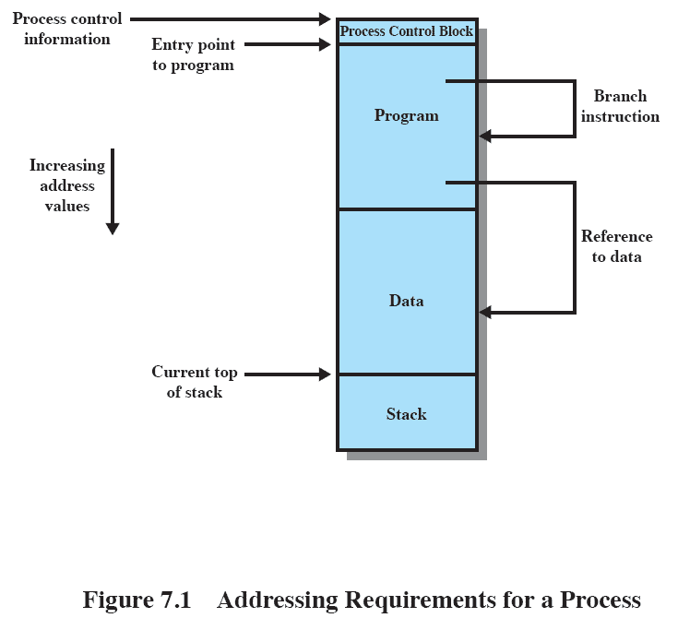
Addressing
Notes:
This figure depicts a process image. Talk the students through this diagram
Assume that the process image occupies a contiguous region of main memory.
The OS needs to know the location of:
process control information
the execution stack,
the entry point to begin execution of the program for this process.
Because the operating system knows this information because it is managing memory and is responsible for bringing this process into main memory. However, the processor must deal with memory references within the program. Branch instructions contain an address to reference the instruction to be executed next. Data reference instructions contain the address of the byte or word of data referenced. Somehow, the processor hardware and operating system software must be able to translate the memory references found in the code of the program into actual physical memory addresses, reflecting the current location of the program in main memory.

Slide 13
Requirements: Protection
Processes should not be able to reference memory locations in another process without permission
Impossible to check absolute addresses at compile time
Must be checked at run time
Notes:
Normally, a user process cannot access any portion of the operating system, neither program nor data.
Usually a program in one process cannot branch to an instruction in another process or access the data area of another process. The processor must be able to abort such instructions at the point of execution.
Note that the memory protection requirement must be satisfied by the processor (hardware) rather than the operating system (software) because the OS cannot anticipate all of the memory references that a program will make. It is only possible to assess the permissibility of a memory reference at the time of execution.
Consider asking the students “why” to point 1 & 2.
Why is it a Bad Thing for one process to be able to read, or even write, to memory occupied by a different process?
Why is it impossible to check absolute addresses at compile time (hint: see relocation)

Slide 14
Requirements: Sharing
Allow several processes to access the same portion of memory
Better to allow each process access to the same copy of the program rather than have their own separate copy
Notes:
Any protection mechanism must have the flexibility to allow several processes to access the same portion of main memory.
Processes that are cooperating on some task may need to share access to the same data structure.

Slide 15
Requirements: Logical Organization
Memory is organized linearly (usually)
Programs are written in modules
Modules can be written and compiled independently
Different degrees of protection given to modules
(read-only, execute-only etc)
Share modules among processes
Segmentation helps here
Notes:
Main memory is usually organized as a linear, or one-dimensional, address space, consisting of a sequence of bytes or words.
Secondary memory, at its physical level, is similarly organized.
This does not correspond to the way in which programs are typically constructed. Most programs are organized into modules. If the operating system and computer hardware can effectively deal with user programs and data in the form of modules of some sort, then a number of advantages can be realized

Slide 16
Requirements: Physical Organization
We cannot leave the programmer with the responsibility to manage memory
Memory available for a program plus its data may be insufficient
Allows various modules to be assigned the same region of memory but is it time consuming to program?
Programmer does not know how much space will be available
Notes:
Because of this, it is clear that the task of moving information between the two levels of memory should be a system responsibility. This task is the essence of memory management.

Slide 17
Partitioning
An early method of managing memory
virtual memory
If we look first at partitioning
Virtual Memory has evolved from the partitioning methods

Slide 18
Types of Partitioning
Fixed Partitioning
Dynamic Partitioning
Simple Paging
Simple Segmentation
Virtual Memory Paging
Virtual Memory Segmentation
Notes:
Don’t dwell on this slide – it is just an indication on the various approaches which will be covered in further detail in other slides

Slide 19
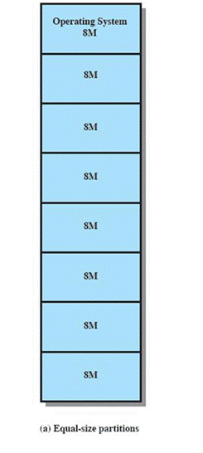
Fixed Partitioning
Equal-size partitions (see fig a)
Any process whose size is less than or equal to the partition size can be loaded into an available partition
The operating system can swap a process out of a partition
If none are in a ready or running state

Slide 20
Fixed Partitioning Problems
A program may not fit in a partition.
The programmer must design the program with overlays
Main memory use is inefficient.
Any program, no matter how small, occupies an entire partition.
This is results in internal fragmentation.

Slide 21
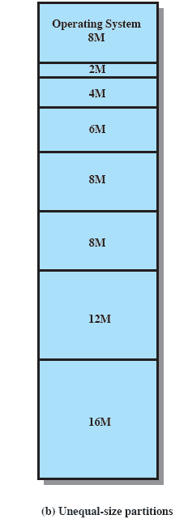
Solution – Unequal Size Partitions
In Fig 7.3b,
Programs up to 16M can be accommodated without overlay
Smaller programs can be placed in smaller partitions, reducing internal fragmentation

Slide 22
Placement Algorithm
Equal-size
Placement is trivial (no options)
Unequal-size
Can assign each process to the smallest partition within which it will fit
Queue for each partition
Processes are assigned in such a way as to minimize wasted memory within a partition

Slide 23
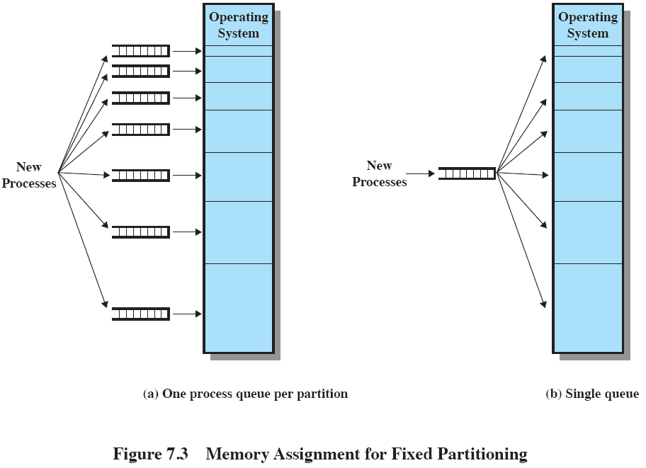
Fixed Partitioning

Slide 24
Remaining Problems with Fixed Partitions
The number of active processes is limited by the system
Pre-determined number of partitions
A large number of very small size process will not use the space efficiently
In either fixed or variable length partition methods
Notes:
Finish by mentioning tat fixed partitioning is almost unknown today

Slide 25
Dynamic Partitioning/Loading
Partitions are of variable length and number
Process is allocated exactly as much memory as required
Routine is not loaded until it is called
Better memory-space utilization; unused routine is never loaded
Useful when large amounts of code are needed to handle infrequently occurring cases

Slide 26
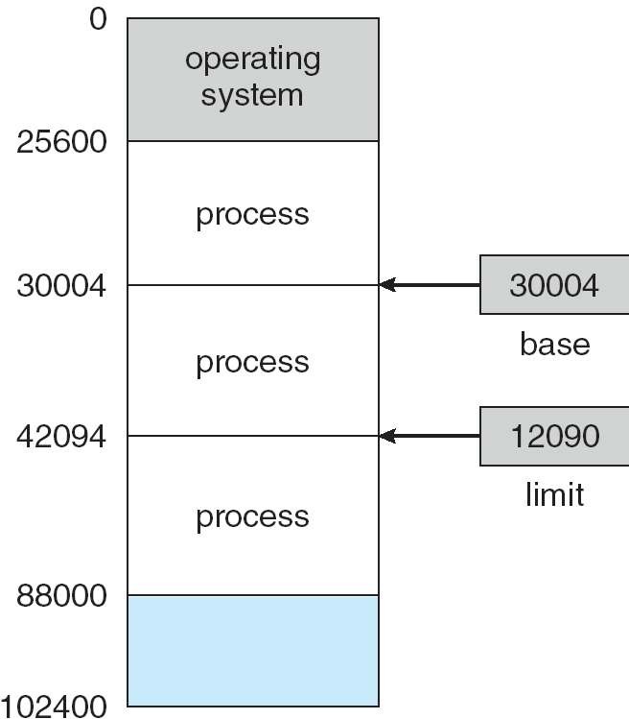
A base and a limit register define a logical address space

Slide 27
Dynamic Partitioning Example
OS (8M)
External Fragmentation
Memory external to all processes is fragmented
Can resolve using compaction
OS moves processes so that they are contiguous
Time consuming and wastes CPU time
P1
(20M)
P2
(14M)
Empty (6M)
P4(8M)
P2
(14M)
Empty (56M)
Empty (6M)
P3
(18M)
Empty (4M)
Refer to Figure 7.4
Notes:
Animated slide
Imagine a system with 64M RAM
Initially, main memory is empty, except for the operating system
Three processes are loaded in – leaving a ‘hole’ too small for any further process
At some point, none of the processes in memory is ready. The operating system swaps out process 2,
Which leaves sufficient room to load a new process, process 4 – but that creates another hole
Later, a point is reached at which none of the processes in main memory is ready, but process 2, in the Ready-Suspend state, is available. Because there is insufficient room in memory for process 2, the operating system swaps process 1 out and swaps process 2 back in leaving yet another hole
Explain External Fragmentation and compaction – mention that compaction implies the capability of dynamic relocation

Slide 28
Contiguous Allocation
Main memory usually into two partitions:
Resident operating system,
User processes
Single-partition allocation
Relocation-register scheme used to protect user processes from each other, and from changing operating-system code and data
Relocation register contains value of smallest physical address
Limit register contains range of logical addresses.

Slide 29
Contiguous Allocation (Cont.)
Multiple-partition allocation
Hole – block of available memory; holes of various size are scattered throughout memory
When a process arrives, it is allocated memory from a hole large enough to accommodate it
Operating system maintains information about: a) allocated partitions b) free partitions (hole)
OS
OS
OS
OS
process 5
process 5
process 5
process 5
process 9
process 9
process 8
process 10
process 2
process 2
process 2
process 2

Slide 30
Dynamic Storage-Allocation Problem
Operating system must decide which free block to allocate to a process
How to satisfy a request of size n from a list of free holes
First-fit:
Best-fit:
Next Fit & Worst-fit:
First-fit and best-fit better than worst-fit in terms of speed and storage utilization

Slide 31
Dynamic Partitioning
First-fit algorithm
Allocate the first hole that is big enough
Scans memory form the beginning and chooses the first available block that is large enough
Fastest
May have many process loaded in the front end of memory that must be searched over when trying to find a free block

Slide 32
Dynamic Partitioning
Best-fit algorithm
Allocate the smallest hole that is big enough;
Chooses the block that is closest in size to the request
Since smallest block is found for process, Produces the smallest leftover hole.
The smallest amount of fragmentation is left
Memory compaction must be done more often

Slide 33
Dynamic Partitioning
Next-Fit & Worst Fit
Allocate the largest hole; must also search entire list. Produces the largest leftover hole.
Scans memory from the location of the last placement
More often allocate a block of memory at the end of memory where the largest block is found
The largest block of memory is broken up into smaller blocks
Compaction is required to obtain a large block at the end of memory

Slide 34
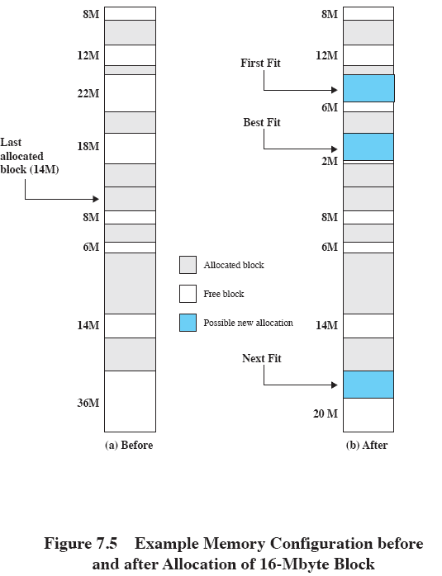
Allocation
Notes:
Slide shows Fig 7.5 - an example memory configuration after a number of placement and swapping-out operations.
The last block that was used was a 22-Mbyte block from which a 14-Mbyte partition was created.
Figure 7.5b shows the difference between the best, first, and next-fit placement algorithms in satisfying a 16-Mbyte allocation request.
Best-fit will search the entire list of available blocks and make use of the 18-Mbyte block, leaving a 2-Mbyte fragment.
First-fit results in a 6-Mbyte fragment, and
Next-fit results in a 20-Mbyte fragment.

Slide 35
Fragmentation
External Fragmentation – total memory space exists to satisfy a request, but it is not contiguous
Internal Fragmentation – allocated memory may be slightly larger than requested memory; this size difference is memory internal to a partition, but not being used

Slide 36
Fragmentation
Reduce external fragmentation by compaction
Shuffle memory contents to place all free memory together in one large block
Compaction is possible only if relocation is dynamic, and is done at execution time
I/O problem
Latch job in memory while it is involved in I/O
Do I/O only into OS buffers

Slide 37
Buddy System
Entire space available is treated as a single block of 2^{U}
If a request of size s where 2^{U-1} < s <= 2^{U}
entire block is allocated
Otherwise block is split into two equal buddies
Process continues until smallest block greater than or equal to s is generated
Notes:
In a fixed partitioning scheme limits the number of active processes and may use space inefficiently if there is a poor match between available partition sizes and process sizes.
A dynamic partitioning scheme is more complex to maintain and includes the overhead of compaction.
An interesting compromise is the buddy system.

Slide 38
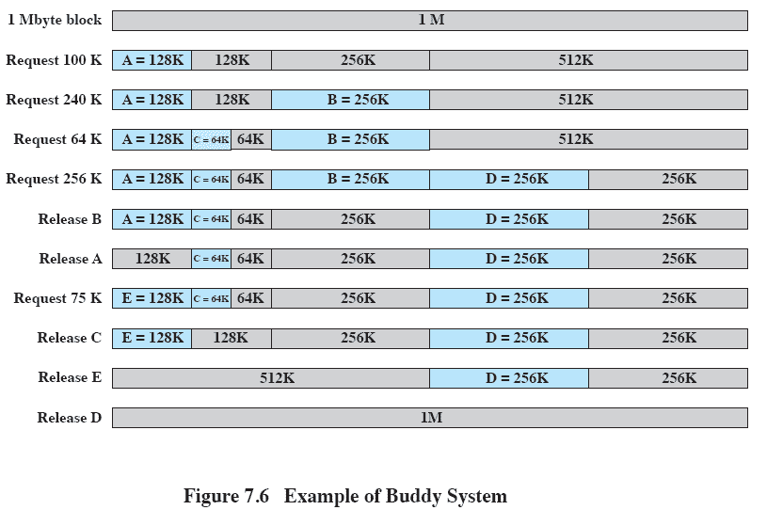
Example of Buddy System
Notes:
Figure 7.6 gives an example using a 1-Mbyte initial block.
The first request,A, is for 100 Kbytes, for which a 128K block is needed.
The initial block is divided into two 512K buddies.
The first of these is divided into two 256K buddies,
and the first of these is divided into two 128K buddies,
one of which is allocated to A.
The next request,B, requires a 256K block. Such a block is already available and is allocated.
The process continues with splitting and coalescing occurring as needed.
Note that when E is released,two 128K buddies are coalesced into a 256K block, which is immediately coalesced with its buddy

Slide 39
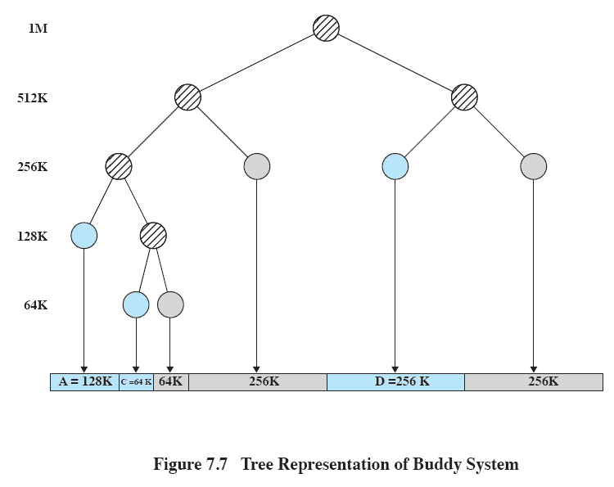
Tree Representation of Buddy System
Notes:
Figure 7.7 shows a binary tree representation of the buddy allocation immediately after the Release B request.
The leaf nodes represent the current partitioning the memory.
If two buddies are leaf nodes, then at least one must be allocated;
otherwise they would be coalesced into a larger block.
The buddy system is a reasonable compromise to overcome the disadvantages of both the fixed and variable partitioning schemes,
But in contemporary operating systems, virtual memory based on paging and segmentation is superior.
However, the buddy system has found application in parallel systems as an efficient means of allocation and release for parallel programs. A modified form of the buddy system is used for UNIX kernel memory allocation (described in Chapter 8).

Slide 40
Relocation
When program loaded into memory the actual (absolute) memory locations are determined
A process may occupy different partitions which means different absolute memory locations during execution
Swapping
Compaction

Slide 41
Addresses
Logical
Reference to a memory location independent of the current assignment of data to memory.
Relative
Address expressed as a location relative to some known point.
Physical or Absolute
The absolute address or actual location in main memory.
Notes:
A translation must be made from both Logical and Relative addresses to arrive at the Absolute address

Slide 42
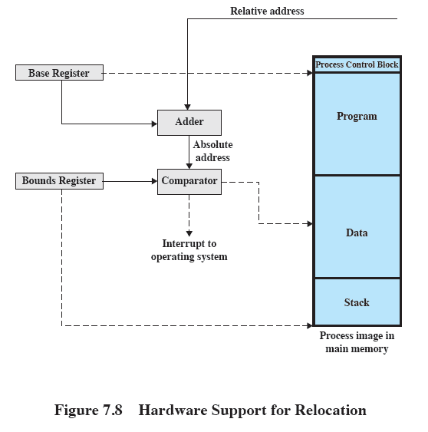
Relocation

Slide 43
Registers Used during Execution
Base register
Starting address for the process
Bounds register
Ending location of the process
These values are set when the process is loaded or when the process is swapped in

Slide 44
Registers Used during Execution
The value of the base register is added to a relative address to produce an absolute address
The resulting address is compared with the value in the bounds register
If the address is not within bounds, an interrupt is generated to the operating system

Slide 45
The End

